Slide 1
AIRLINE MANAGEMENT SYSTEM
Rishika P (24102281)
Riya Treesa Rajeevu (24102804)
Sania Mathew (24102275)
Savanth Sanju (24102169)
Project Coordinator: Athira K R

Slide 2
INTRODUCTION
The Airline Management System (AMS) is a web-based application designed to simplify and automate important airline operations. The system provides a centralized platform for managing flight information, passenger bookings, staff records, and staff assignments.
The system supports different types of users, including Passengers, Administrators, Pilots, Flight Hostesses, and Ground Staff, with role-based access to ensure that each user can access the functions relevant to their responsibilities. Passengers can search for available flights, reserve seats, view their bookings, and cancel tickets, while administrators can manage flights, staff, bookings, and staff assignments. Staff members can access their assigned flight and schedule information.
The system aims to provide an organized and efficient platform for managing airline-related activities while reducing manual effort and improving the accessibility and consistency of airline information.
Airline Management System
2

Slide 3
AIM
The aim of the Airline Management System (AMS) is to develop a centralized, web-based platform that efficiently manages and automates major airline operations, including flight management, passenger bookings, ticket management, staff management, and staff assignments. The system is intended to simplify the process of searching and booking flights for passengers while providing administrators with the necessary tools to manage flight information, booking records, staff details, and staff schedules.
The system also aims to provide role-based access for passengers, administrators, pilots, flight hostesses, and ground staff, allowing each user to access the functions relevant to their responsibilities. By bringing these operations together into a single platform, the system aims to reduce manual effort, improve data consistency, simplify airline workflows, and provide efficient access to flight and booking information..
Airline Management System
3

Slide 4
OBJECTIVE
The main objectives of the Airline Management System are:
To provide a centralized platform for managing airline operations.
To allow passengers to search for available flights and book tickets easily.
To enable passengers to view and cancel their bookings.
To allow administrators to add, update, view, and delete flight information.
To maintain and manage information about pilots, flight hostesses, and ground staff.
To allow administrators to assign staff members to flights and schedules.
To allow staff members to view their assigned schedules.
To provide role-based access control for passengers, administrators, and staff.
To maintain accurate and consistent airline-related information.
To reduce manual effort and improve the efficiency of airline operations.
Airline Management System
4

Slide 5
SCOPE
The scope of the Airline Management System covers the centralized management of flight information, passenger bookings, and airline staff operations.
The system includes the following major areas:
Passenger Management
Passengers can register and log in, search for available flights, view flight details, book tickets, view existing bookings, and cancel bookings.
Flight Management
Administrators can add new flights, view flight details, update flight information, delete flights, and maintain flight schedules and flight status.
Booking Management
The system allows passengers to create and confirm bookings, generate ticket details, view booking information, and cancel existing bookings.
Airline Management System
5

Slide 6
Staff Management
Administrators can manage airline staff, including Pilots, Flight Hostesses, and Ground Staff, by adding, updating, viewing, and deleting staff records.
Staff Assignment
Administrators can assign staff members to flights or schedules. The assigned schedule can then be accessed by the corresponding staff member.
Role-Based Access
The system provides different functionalities according to the user's role. Passengers, administrators, pilots, flight hostesses, and ground staff have access to the functions relevant to their responsibilities.

Slide 7
FUNCTIONAL REQUIREMENTS
The functional requirements describe the major functions that the Airline Management System should provide to passengers, administrators, and staff members.
FR-01: User Login
•The system shall allow passengers, administrators, and staff members to log in using valid credentials.
•The system shall verify the entered username/email and password.
•The system shall display a login failed message when invalid credentials are entered.
•The system shall provide access according to the user's role.
FR-02: Passenger Registration and Login
•The system shall allow passengers to create an account.
•The system shall store passenger details such as name, email, phone number, address, and password.
•The system shall authenticate passengers during login.
Airline Management System — SRS Presentation
6

Slide 8
FR-03: Search Flights
•The system shall allow passengers to search for available flights.
•Passengers shall be able to search flights using details such as departure, arrival, and travel date.
•The system shall display the available flight details.
•The system shall display the flight status and relevant schedule information.
FR-04: Book Ticket
•The system shall allow passengers to select an available flight and book a ticket.
•The system shall collect the required passenger and booking information.
•The system shall generate a booking after successful booking.
•The system shall generate ticket details for the confirmed booking.
•The system shall display a booking failed message if the booking cannot be completed.
FR-05: Confirm Booking
•The system shall allow passengers to confirm their selected booking.
•The system shall store the booking details after confirmation.
•The system shall generate a booking ID/ticket for a successful booking.
•The system shall update the booking status.

Slide 9
FR-06: View Booking
•The system shall allow passengers to view their existing bookings.
•The system shall display booking details such as booking ID, flight details, date, time, ticket details, and booking status.
FR-07: Cancel Booking
•The system shall allow passengers to cancel an existing booking.
•The system shall update the booking status after cancellation.
•The system shall display the updated booking information.
ADMIN
FR-08: Admin Login
•The system shall allow administrators to log in using valid administrator credentials.
•The system shall verify administrator credentials.
•The system shall provide access to administrator functions after successful login.

Slide 10
FR-10: Add Flight
•The administrator shall be able to add a new flight.
•The system shall store details such as flight number, departure, arrival, departure time, arrival time, and status.
•The newly added flight shall become available for passengers to search.
FR-11: Update Flight Details
•The administrator shall be able to modify existing flight information.
•The system shall update the modified information in the database.
•Updated information shall be displayed to passengers when they search for flights.
FR-12: Delete Flight
•The administrator shall be able to delete a flight from the system.
•The system shall remove or deactivate the selected flight.
•Deleted/inactive flights shall not be available for new bookings.

Slide 11
FR-14: Add Staff
•The administrator shall be able to add new staff members.
•The system shall store staff details such as staff ID, name, phone number, address, and role.
FR-15: Update Staff Details
•The administrator shall be able to modify staff information.
•The system shall update the modified staff details.
FR-16: Delete Staff
•The administrator shall be able to remove staff members from the system.
•The system shall update the staff records accordingly.
FR-17: Assign Staff Schedule
•The administrator shall be able to assign staff members to flights/schedules.
•The system shall maintain the assigned schedule.
•The assigned schedule shall be available for the corresponding staff member to view.

Slide 12
FR-18: View Bookings
•The administrator shall be able to view passenger bookings.
•The system shall display booking information such as passenger details, flight details, booking ID, ticket details, and booking status
STAFF
FR-20: Staff Login
•The system shall allow staff members to log in using valid credentials.
•The system shall verify the staff credentials.
•The system shall provide access to staff-specific functions after successful login.

Slide 13
FR-21: View Assigned Schedule
•The system shall allow staff members to view their assigned schedules.
•The schedule shall contain relevant flight/date/time information.
•Staff members shall only be able to view schedules assigned to them.

Slide 14
NON-FUNCTIONAL REQUIREMENTS
NFR1: Performance
The system shall provide quick responses when users search for flights, view schedules, make bookings, or cancel bookings.
NFR2: Reliability
The system shall perform flight, passenger, booking, and schedule operations accurately and consistently without data loss.
NFR3: Availability
The system shall be available to users whenever required, except during scheduled maintenance.
NFR4: Security
The system shall protect user, staff, flight, and booking information from unauthorized access.
NFR5: Usability
The system shall provide a simple and user-friendly interface for passengers and authorized staff to perform their tasks easily.
Airline Management System — SRS Presentation
7

Slide 15
NFR6: Maintainability
The system shall be designed so that changes, corrections, and future enhancements can be implemented with minimal impact on existing functions.
NFR7: Scalability
The system shall support an increasing number of passengers, staff members, flights, schedules, and bookings without significant degradation in performance.
NFR8: Portability
The system shall be accessible through commonly used web browsers and on different devices such as desktops, tablets, and mobile devices.

Slide 16
MODULES
PASSENGER MODULE
The Passenger Module handles operations related to users booking flights. Passengers can register, log in securely, search for available flights, and book tickets. They can view their booking history and cancel bookings when required. The system ensures real-time seat availability and prevents overbooking. The module provides a user-friendly interface for managing all passenger-related activities.
ADMIN MODULE
The Admin Module is responsible for managing the entire system. The administrator can add and manage flights, including updating flight details and seat availability. Admin can also manage staff such as pilots, hostesses, and ground staff by adding, viewing, and deleting their records. Additionally, the admin assigns staff to specific flights using the staff scheduling system. This module ensures proper coordination and smooth functioning of airline operation.
Airline Management System
8

Slide 17
STAFF MODULE
The Staff Module includes pilots, hostesses, and ground staff. Staff members can register and log in
to the system using their credentials. Once logged in, they can view the flights assigned to them. This
module helps staff members stay updated with their schedules and ensures efficient management of
airline operations
This implementation ensures a secure, scalable, and efficient airline management system that
enhances operational efficiency and user experience

Slide 18
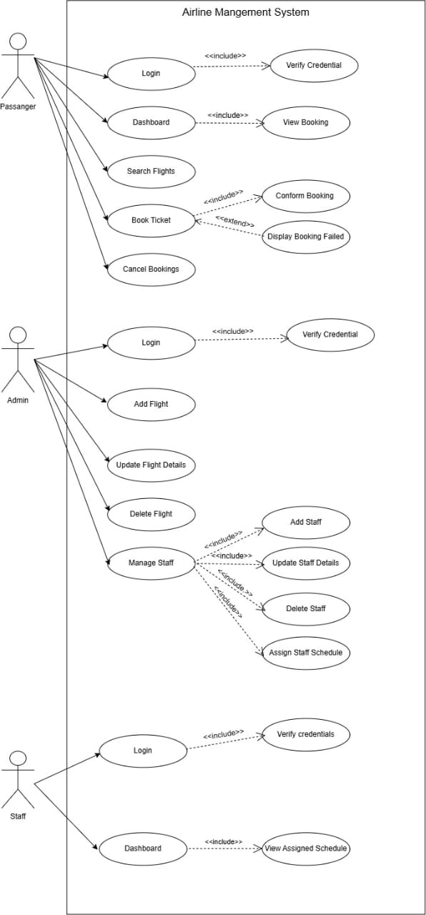
USE CASE DIAGRAM
.
Airline Management System
9

Slide 19
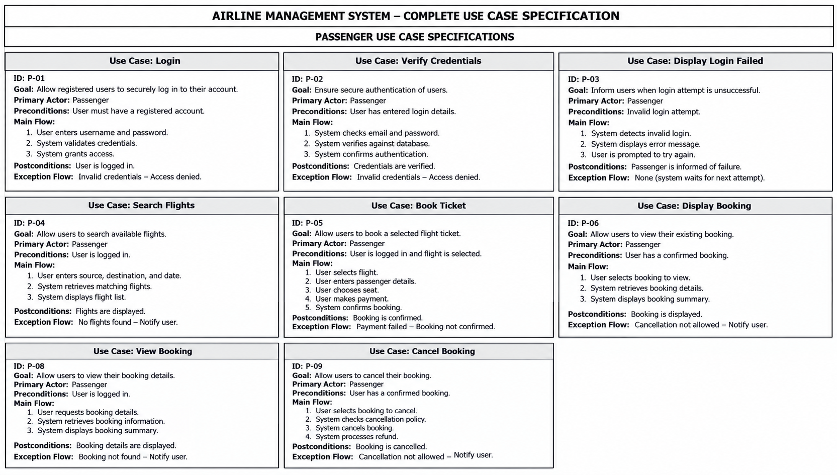
USE CASE SPECIFICATION
AIRLINE MANAGEMENT SYSTEM
10

Slide 20
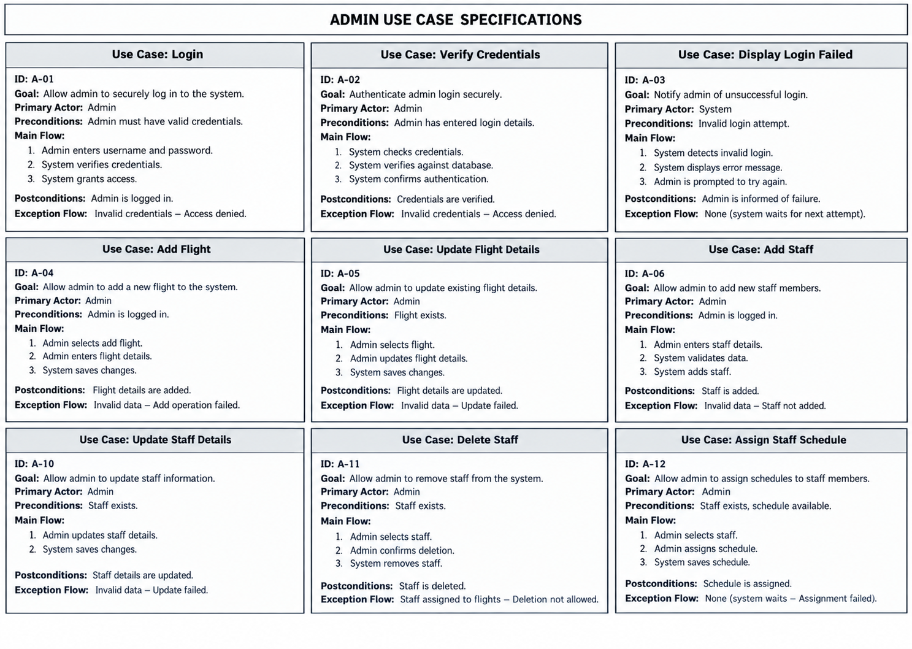
Airline Management System
11

Slide 21
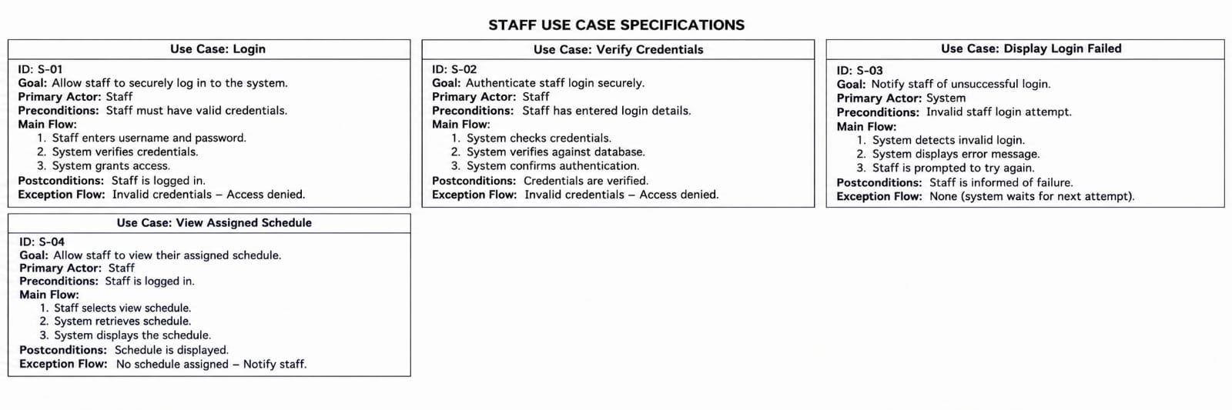
Airline Management System
12

Slide 22
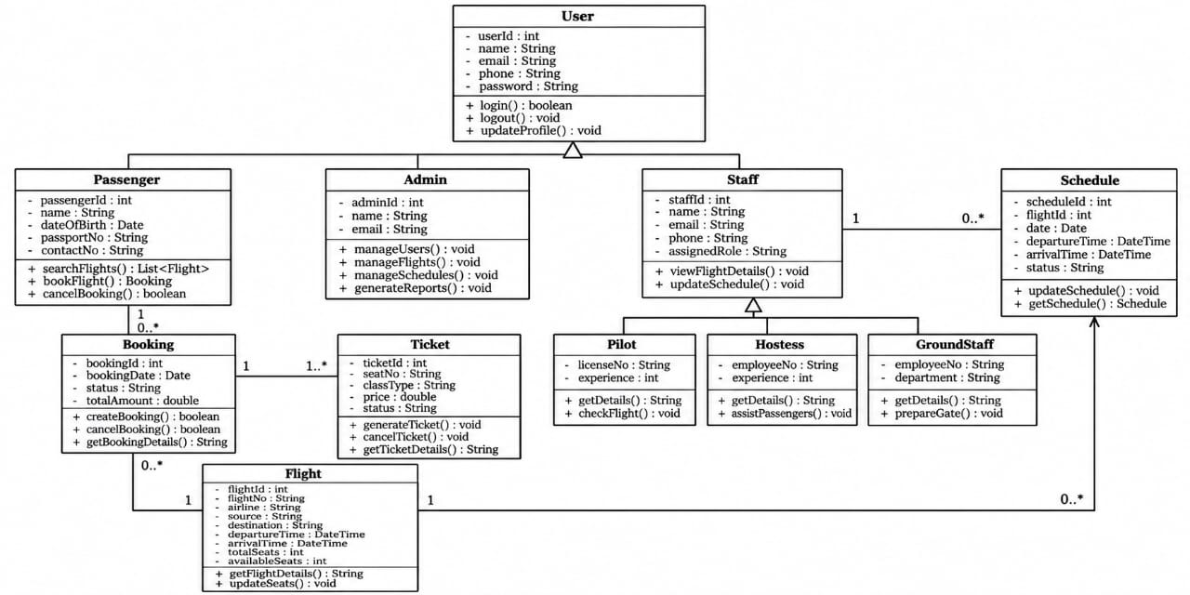
CLASS DIAGRAM
Airline Management System
13

Slide 23
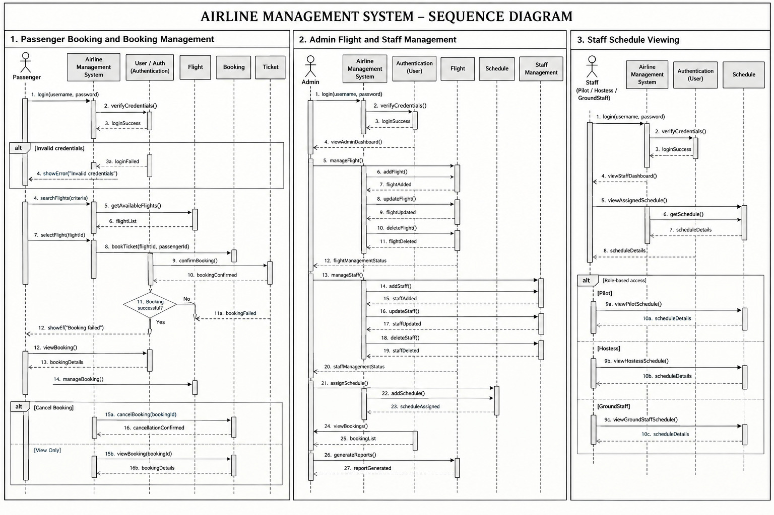
SEQUENCE DIAGRAM
s.
Airline Management System
14

Slide 24
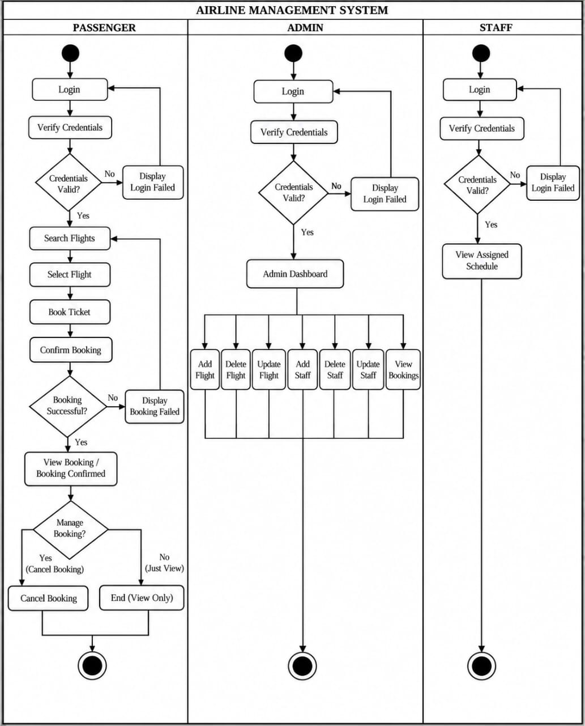
ACTIVITY DIAGRAM
Airline Management System
15

Slide 25
CONCLUSION
The Airline Management System automates flight scheduling, passenger booking and staff management in a single centralized platform.
Applying OOP concepts — classes, inheritance, encapsulation and abstraction — results in a modular and maintainable system.
The system reduces manual effort, minimizes booking and scheduling errors, and gives administrators real-time control over flight operations.
Designed with scalability and cloud deployment in mind for future growth.
Airline Management System
16

Slide 26
REFERENCE
PHP Documentation
MySQL Documentation
HTML5 Documentation
CSS3 Documentation
Object-Oriented Programming concepts
Software Requirements Specification (SRS) guidelines
Airline Management System
17

